Slide 1
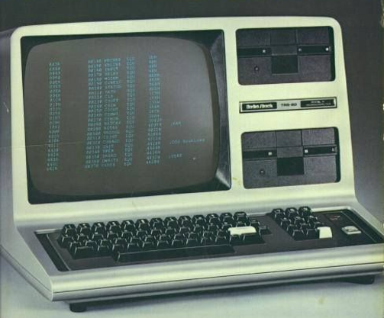
Representing Instructions in the Computer
Notes:
The computer is a TRS-80 (Tandy Corporation, that along with Apple and Commodore gave the start to the “microcomputer revolution”), from 1977. Intestingly, it used a Zilog Z80 instead of a more common Intel 8080. Zilog is a company based in Milpitas
(the picture is taken from a magazine of the time… the text in the monitor seems off…)

Slide 2
Representing Instructions in the Computer
In MIPS assembly language, registers $s0 to $s7 map onto registers 16 to 23, and registers $t0 to $t7 map onto registers 8 to 15.
$s0 means register 16
$s1 means register 17
$s2 means register 18
…
$t0 means register 8
$t1 means register 9
. . .

Slide 3
add $t0,$s1,$s2
The first and last fields (containing 0 and 32 in this case) in combination tell the MIPS computer that this instruction performs addition.
The second field gives the number of the register that is the first source operand of the addition operation (17 $s1)
The third field gives the other source operand for the addition (18 $s2)
The fourth field contains the number of the register that is to receive the sum (8 $t0).
The fifth field is unused in this instruction, so it is set to 0.

Slide 4
add $t0,$s1,$s2
The first and last fields (containing 0 and 32 in this case) in combination tell the MIPS computer that this instruction performs addition.
The second field gives the number of the register that is the first source operand of the addition operation (17 $s1)
The third field gives the other source operand for the addition (18 $s2)
The fourth field contains the number of the register that is to receive the sum (8 $t0).
The fifth field is unused in this instruction, so it is set to 0.
0 17 18 8 0 32

Slide 5
This layout of the instruction is called the instruction format.
This MIPS instruction takes exactly 32 bits—the same size as a data word.
All MIPS instructions are 32 bits long.

Slide 6
MIPS Field
Here is the meaning of each name of the fi elds in MIPS instructions:
■ op: Basic operation of the instruction, traditionally called the opcode
■ rs: The first register source operand
■ rt: The second register source operand
■ rd: The register destination operand, it gets the result of the operation
■ shamt: Shift amount
■ funct: Function. This field, often called the function code, selects the specific variant of the operation in the op field

Slide 7
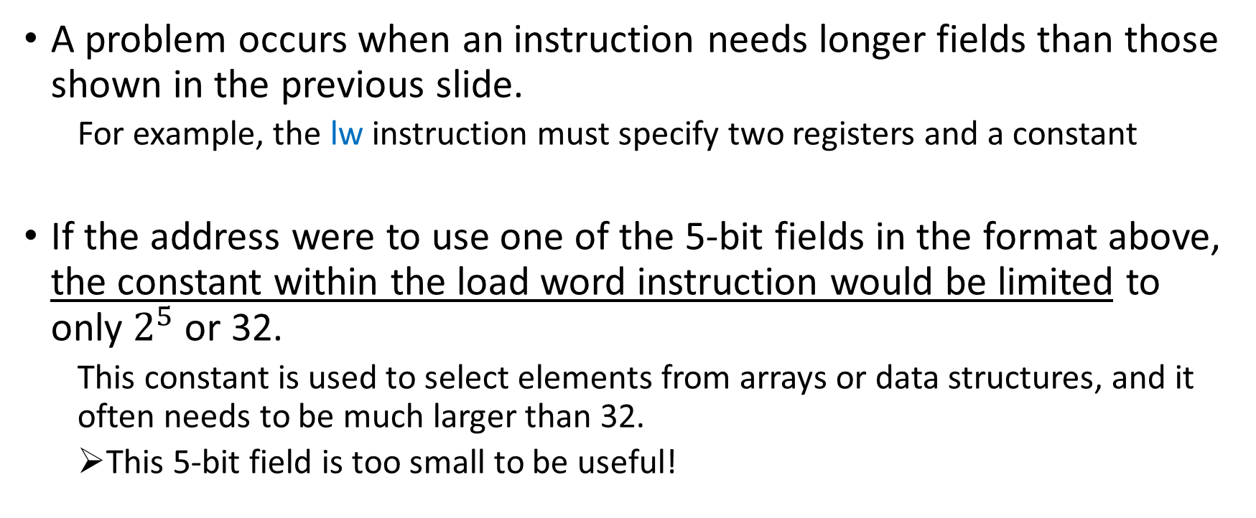
A problem occurs when an instruction needs longer fields than those shown in the previous slide.
For example, the lw instruction must specify two registers and a constant
If the address were to use one of the 5-bit fields in the format above, the constant within the load word instruction would be limited to only $2^{5}$or 32.
This constant is used to select elements from arrays or data structures, and it often needs to be much larger than 32.
This 5-bit field is too small to be useful!

Slide 8
Design Principle 3: Good design demands good compromises.
The compromise chosen by the MIPS designers is to keep all instructions the same length
Requiring different kinds of instruction formats for different kinds of instructions.

Slide 9

For example, the format below is called R-type (for register) or R-format.
A second type of instruction format is called I-type (for immediate) or I-format and is used by the immediate and data transfer instructions.

Slide 10

The 16-bit address means a lw instruction can load any word within a region of $±2^{15}$ or 32,768 bytes ($±2^{13}$or 8192 words) of the address in the base register rs
Similarly, add immediate is limited to constants no larger than $±2^{15}$

Slide 11
lw $t0,32($s3) # Temporary reg $t0 gets A[8]
19 (for $s3) is placed in the rs field
8 (for $t0) is placed in the rt field
32 is placed in the address field
Note that the meaning of the rt field has changed for this instruction: in a load word instruction, the rt field specifies the destination register, which receives the result of the load.

Slide 12
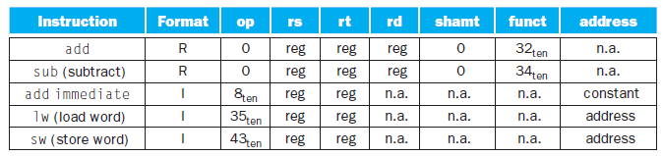
How does the hardware distinguish the formats?
By the values in the first field
Each format is assigned a distinct set of values in the first field (op) so that the hardware knows whether to treat the last half of the instruction as three fields (R-type) or as a single field (I-type).

Slide 13
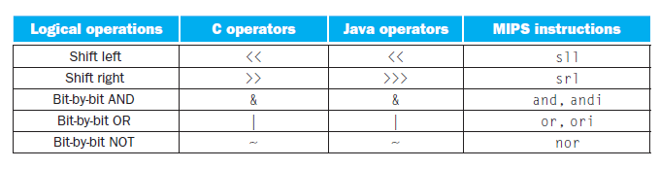
Logical Operations
The first class of such operations is called shifts
They move all the bits in a word to the left or right, filling the emptied bits with 0s.

Slide 14
0000 0000 0000 0000 0000 0000 0000 1001two = 9ten
If the instruction to shift left by 4 was executed, the new value would be:
0000 0000 0000 0000 0000 0000 1001 0000two = 144ten
Notes:
9 * 2^4 = 144

Slide 15
The dual of a shift left is a shift right
The actual name of the two MIPS shift instructions are called shift left logical (sll) and shift right logical (srl)

Slide 16
Assuming that the original value was in register $s0 and the result should go in register $t2:
sll $t2,$s0,4 # reg $t2 = reg $s0 << 4 bits
The shamt field in the R-format is used in shift instructions, it stands for shift amount

Slide 17

The encoding of sll is 0 in both the op and funct fields
rd contains 10 (register $t2) and rt contains 16 (register $s0)
shamt contains 4
The rs field is unused and thus is set to 0
sll $t2,$s0,4 # reg $t2 = reg $s0 << 4 bits

Slide 18
Another useful operation that isolates fields is AND
AND is a bit-by-bit operation that leaves a 1 in the result only if both bits of the operands are 1.

Slide 19
If register $t2 contains:
0000 0000 0000 0000 0000 1101 1100 0000
And register $t1 contains:
0000 0000 0000 0000 0011 1100 0000 0000
After executing the MIPS instruction:
and $t0,$t1,$t2 # reg $t0 = reg $t1 & reg $t2
The value of register $t0 would be:
0000 0000 0000 0000 0000 1100 0000 0000
Notes:
Mask: AND can apply a bit pattern to a set of bits to force 0s where there is a 0 in the bit pattern.
Such a bit pattern in conjunction with AND is traditionally called a mask, since the mask “conceals” some bits.

Slide 20
There is the dual to AND, called OR
It is a bit-by-bit operation that places a 1 in the result if either operand bit is a 1.

Slide 21
If register $t2 contains:
0000 0000 0000 0000 0000 1101 1100 0000
And register $t1 contains:
0000 0000 0000 0000 0011 1100 0000 0000
After executing the MIPS instruction:
or $t0,$t1,$t2 # reg $t0 = reg $t1 | reg $t2
This is the value in register $t0:
0000 0000 0000 0000 0011 1101 1100 0000

Slide 22
NOT takes one operand and places a 1 in the result if one operand bit is a 0, and vice versa.

Slide 23
In keeping with the three-operand format, the designers of MIPS decided to include the instruction NOR (NOT OR) instead of NOT
If one operand is zero, then it is equivalent to:
NOT: A NOR 0 = NOT (A OR 0) = NOT (A)

Slide 24
If register $t3 contains:
0000 0000 0000 0000 0000 0000 0000 0000
And register $t1 contains:
0000 0000 0000 0000 0011 1100 0000 0000
After executing the MIPS instruction:
nor $t0,$t1,$t3 # reg $t0 = ~ (reg $t1 | reg $t3)
This is the value in register $t0:
1111 1111 1111 1111 1100 0011 1111 1111

Slide 25
Constants are useful in AND and OR logical operations as well as in arithmetic operations, so MIPS also provides the instructions and immediate (andi) and or immediate (ori)
Constants are rare for NOR, since its main use is to invert the bits of a single operand; thus, the MIPS instruction set architecture has no immediate version of NOR

